Slide 1


TELECOM
CUSTOMER CHURN
Kholoud Yehia

Slide 2

INTRODUCTION
Customer churn is a tendency of customers to cancel their subscriptions to a service they have been using and, hence, stop being a client of that service.
Customer churn rate is a very important indicator of customer satisfaction and the overall business wellness of the company.

Slide 3

OBJECTIVE
Churn Prediction
Develop models to classify customers as likely to churn or remain.
Apply multiple algorithms and select the best model based on evaluation metrics.
Customer Segmentation
Implement clustering algorithms to segment customers based on their behavior and demographics.
Visualization & Reporting
Visualize the churn prediction results, customer clusters, and their characteristics.
Deployment
Deploy the model to a production environment where it can make real-time predictions on new customer data, ensuring continuous monitoring and updates for optimal performance.

Slide 4
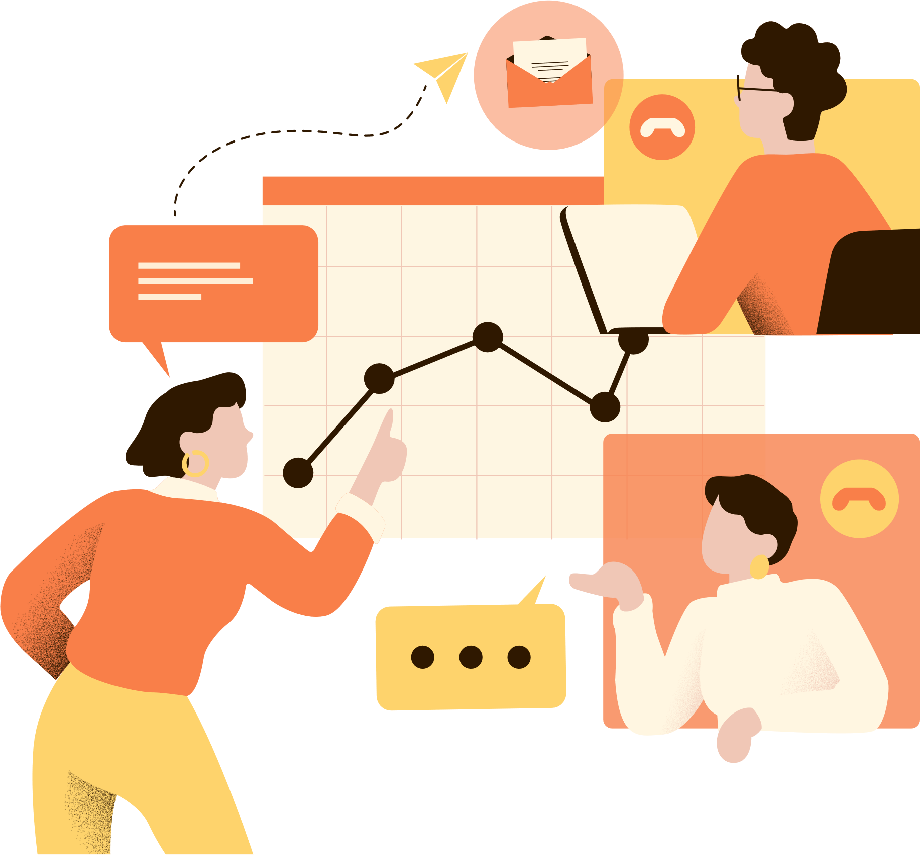
DATASET DESCRIPTION
Dataset Source: Kaggle, in csv format.
Dataset contains 7043 rows and 21 columns.
There is no missing values for the provided input dataset.
Dataset has a skewness and imbalanced label.
Target variable is Churn.

Slide 5

VISUALIZATION & INSIGHTS

Slide 6
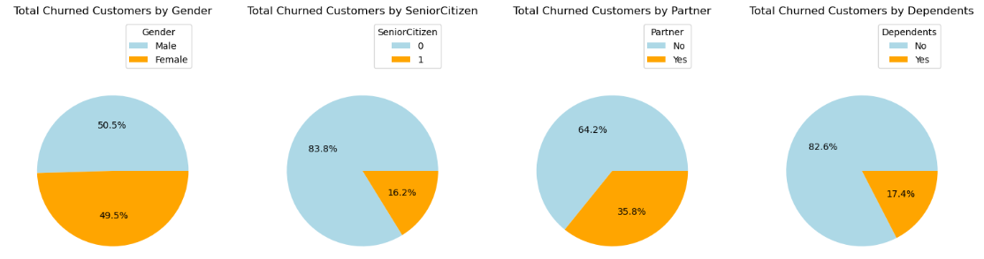
Based on Customer Information:
Observations:
The churn rate for male and female customers is quite similar.
Customers no partner and no dependents are more likely to churn.
Only 16% of the customers are senior citizens, indicating that the majority of our customers are younger individuals.

Slide 7
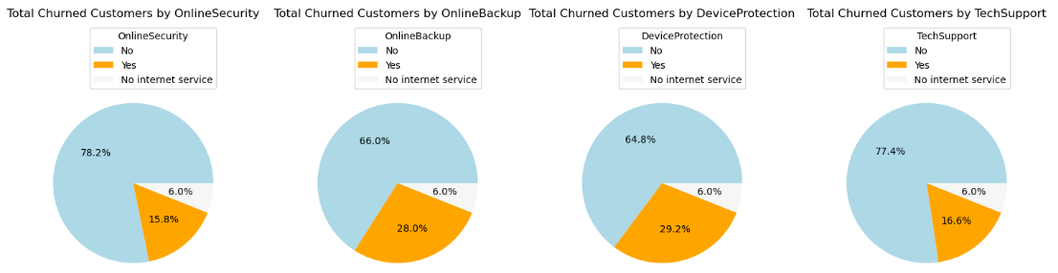
Based on Services Subscribed by the Customer:
Observation: The importance of providing OnlineSecurity, OnlineBackup, DeviceProtection, and TechSupport. An average of 71.6% of customers churned due to the lack of these services!

Slide 8
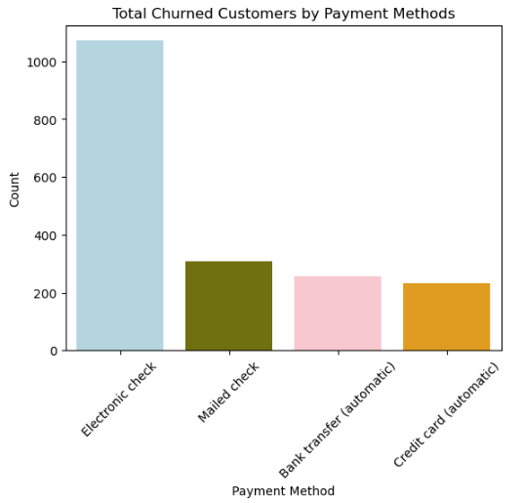
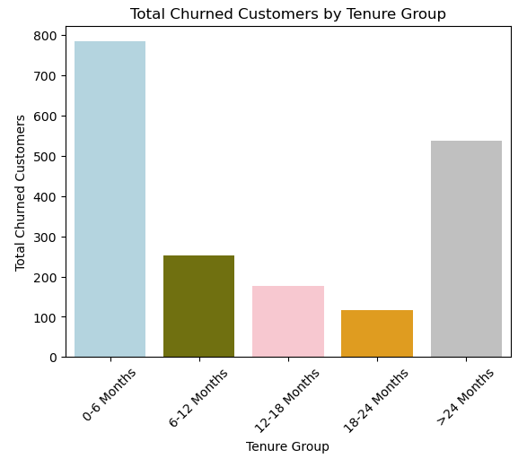
Observation: Customers clearly resented the use of the Electronic Check as a payment method.
Observation: Customers tend to cancel their service and churn within the first 6 months.

Slide 9
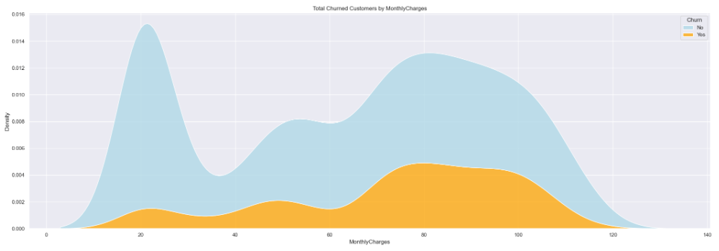
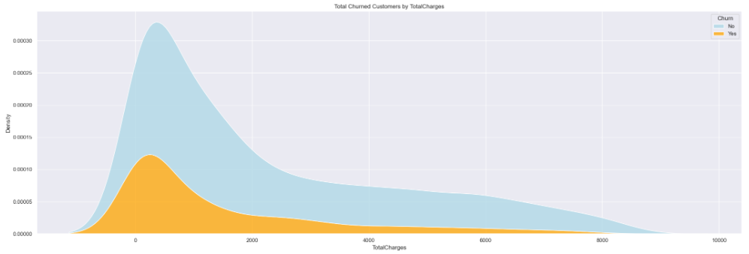
Monthly Charges Vs. Total Charges
Observation: As monthly charges increase, we observe a higher density (from 60 to 120), indicating that customer churn is rising with the increase in monthly charges.
Observation: high churn occurs when total charges are lower. The highest churn is seen within the 0-2000 total charges range.

Slide 10

MACHINE
LEARNING
MODEL
1- Supervised
classify customers as likely to churn or remain

Slide 11
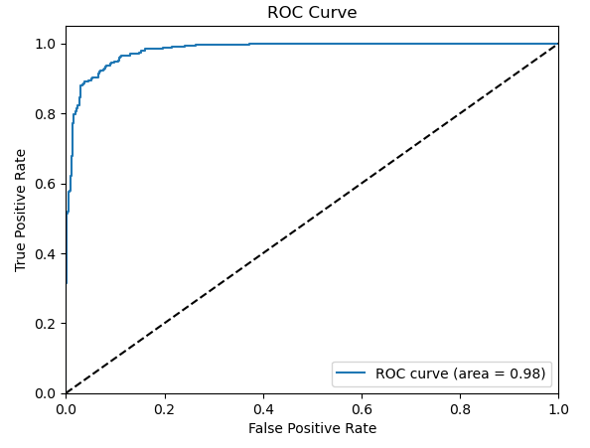
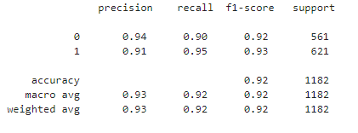
Logistic Regression
The logistic regression model achieved an accuracy of 92% and ROC AUC of 98%

Slide 12
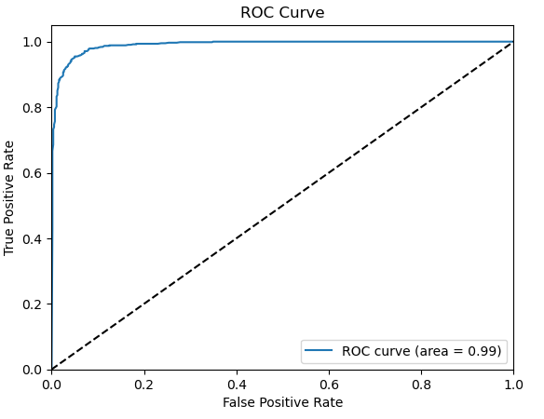
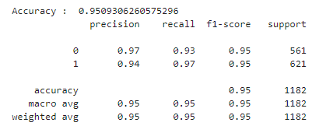
Random Forest
The random forest model achieved an accuracy of 95% and ROC AUC of 98.9%

Slide 13
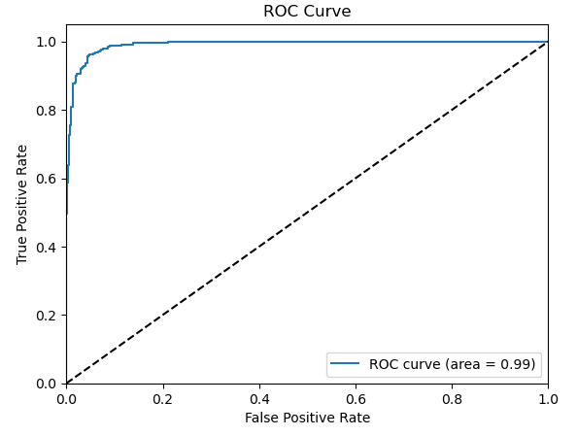
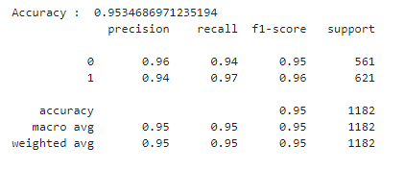
XGBoost Classifier
The XGBoost model achieved an accuracy of 95% and ROC AUC of 99%

Slide 14
MACHINE
LEARNING
MODEL
1- Unsupervised
segment customers based on their behavior and demographics.

Slide 15
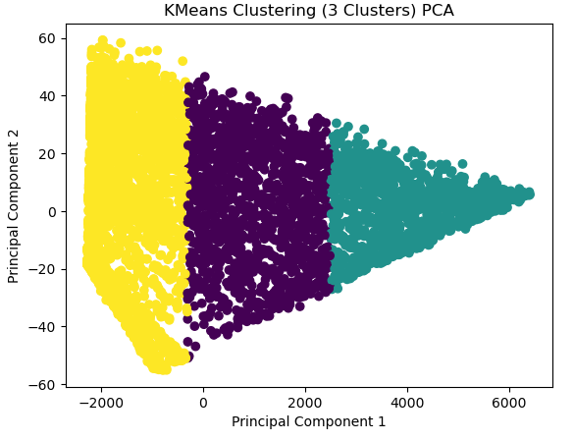
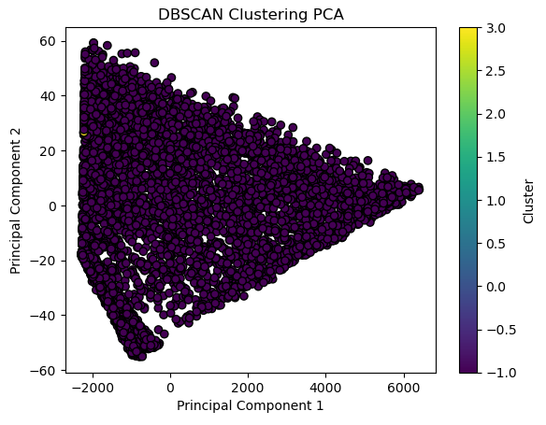
KMeans
DBSCAN

Slide 16

MODEL DEPLOYMENT
Using Streamlit app
Link Here!

Slide 17
SUMMARY OF
KEY ACHIEVEMENTS
Our goal was to identify clients which are likely to churn, so we can do special-purpose marketing strategies to avoid the churn event. For this we evaluated differently preprocessed datasets and different classifiers.
We apply SMOTEENN for both oversampling and cleaning for imbalanced data in ‘Churn’
In the classification chapter we have trained several different classifiers, including a Logistic Regression, a Random Forest, and a XGBoost Classifier. It was found that the best performance in accuracy, as well as f1-score and AUC is achieved by the XGBoost with 95%.
In the clustering chapter, we have trained two different algorithms, Kmeans and DBSCAN. It was found that the best performace in Silhouette Score is achieved by DBSCAN with 74%

Slide 18

THANK YOU

